Slide 1
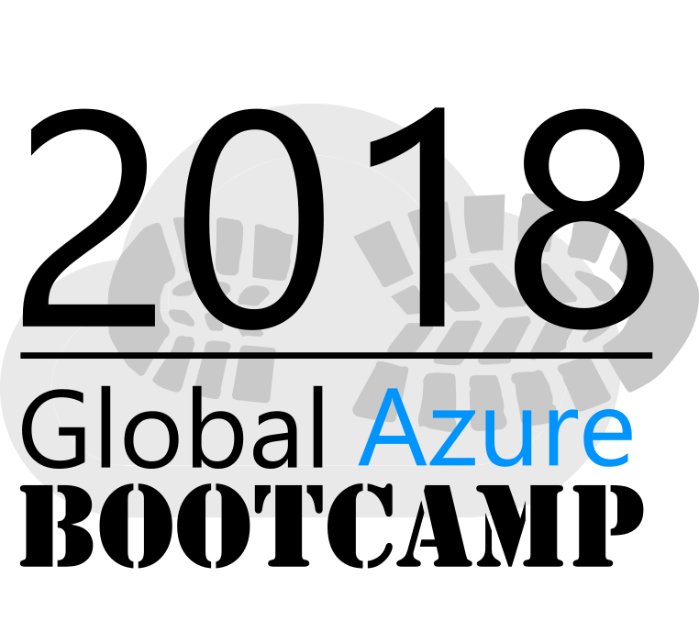





Sponsors for Azure Bootcamp

Slide 2
Predictive Analytics with Spark in Azure HDInsight
Ingyu Lee
Troy University
https://github.com/Azure-Bootcamp-Troy/SparksInHDInsight

Slide 3
Content
What is HDInsight?
What is Spark?
What is RDD?
What is DataFrames?
What is Spark SQL?
What is MLLib?
References
Microsoft DAT202.3x: Spark in Azure HDInsight
Microsoft DAT202.2x: Real-Time Analytics with Hadoop in Azure HDInsight
Microsoft DAT202.1x: Big Data with Hadoop in Azure HDInsight
Microsoft Virtual Academy: Spark on HDInsight
UCB Sparks: CS100, CS105, CS110, CS120, CS190
UCSD Big Data Series (Coursera)
Yandex: Big Data Series (Coursera)

Slide 4
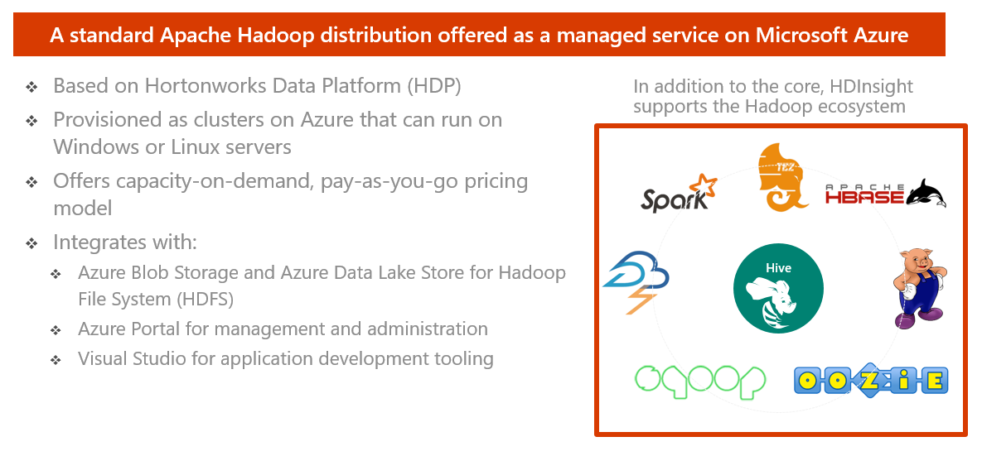
HDInsight – What is it?

Slide 5
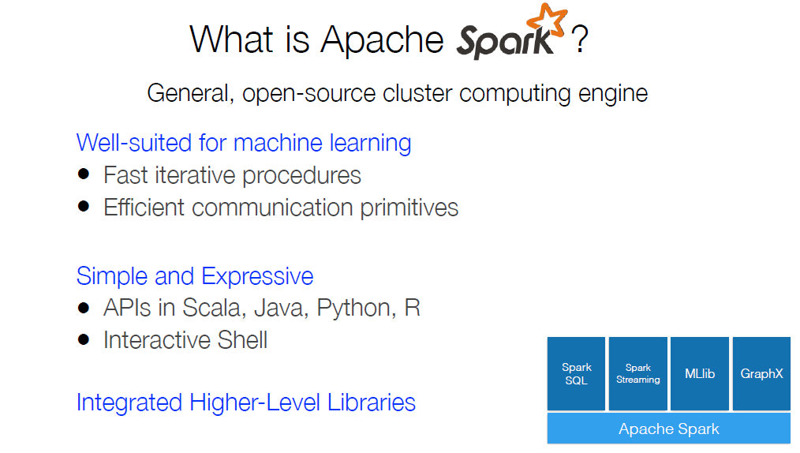
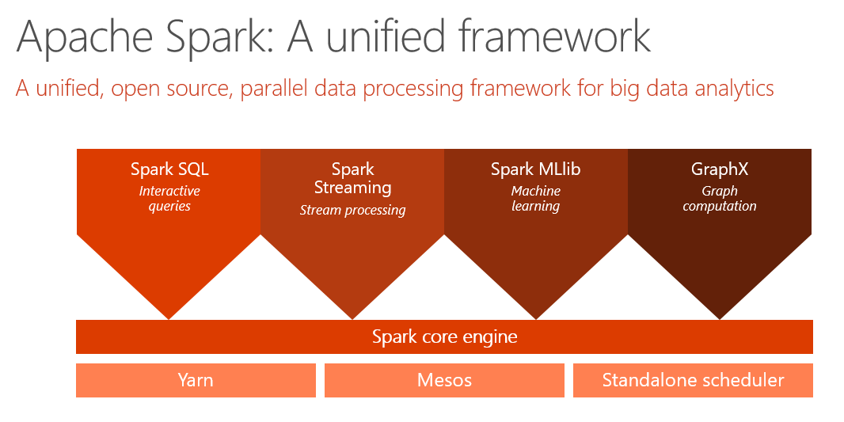

Slide 6
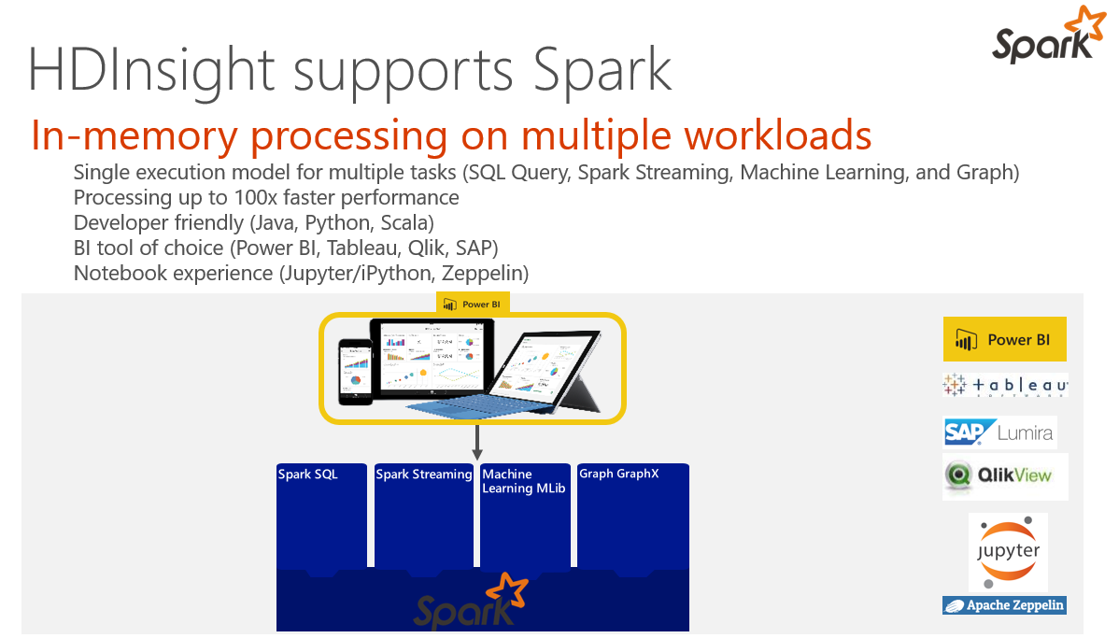

Slide 7
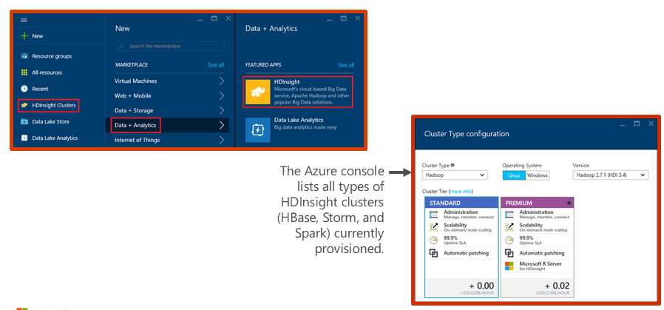
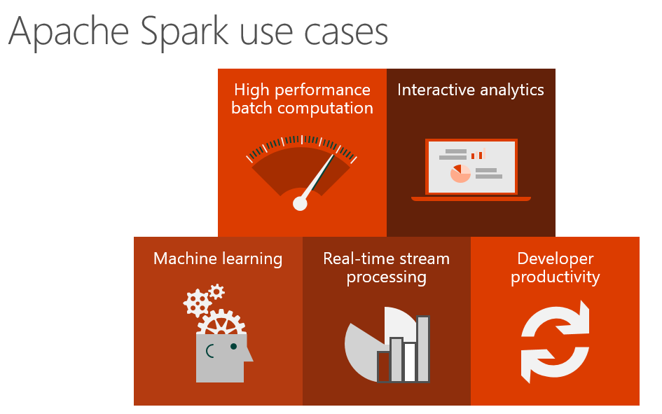
Demo: Creating an HDInsight Spark cluster

Slide 8
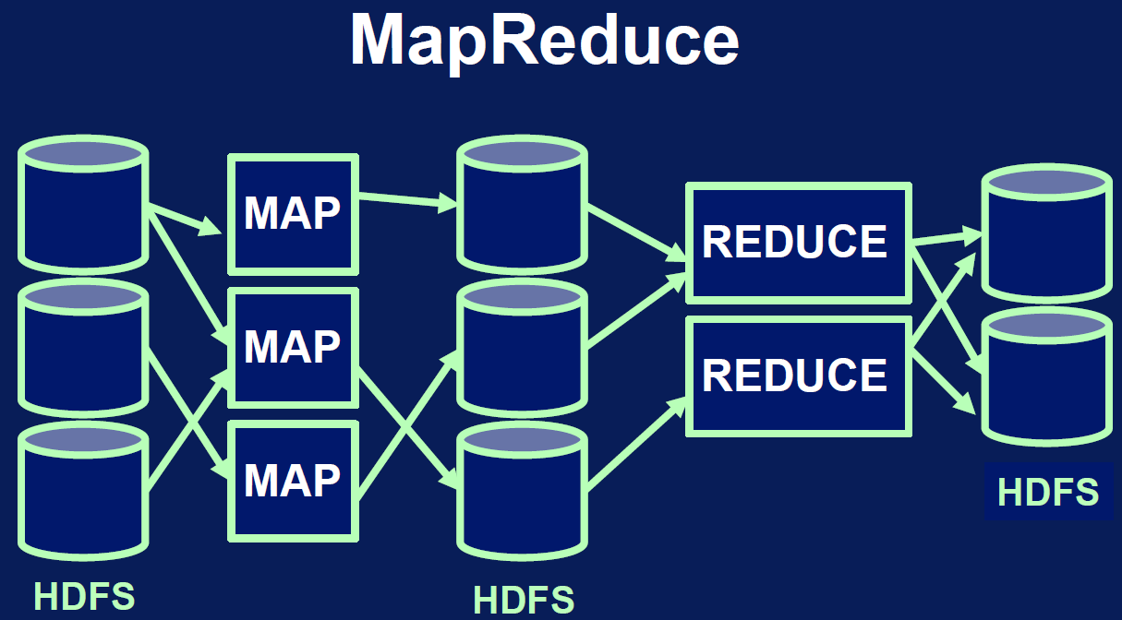
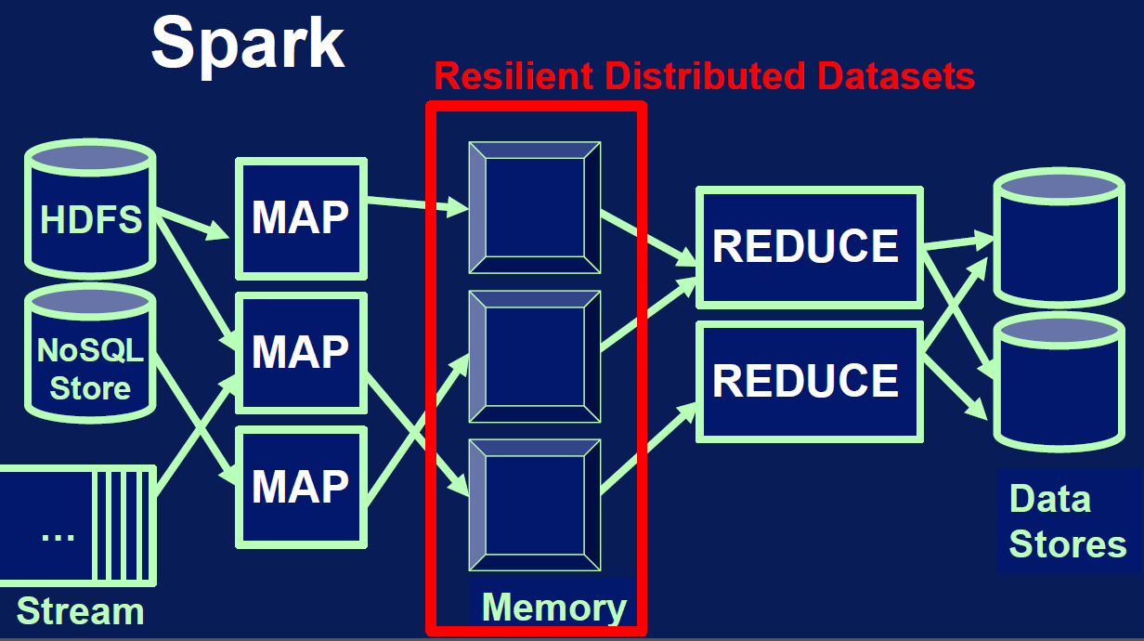
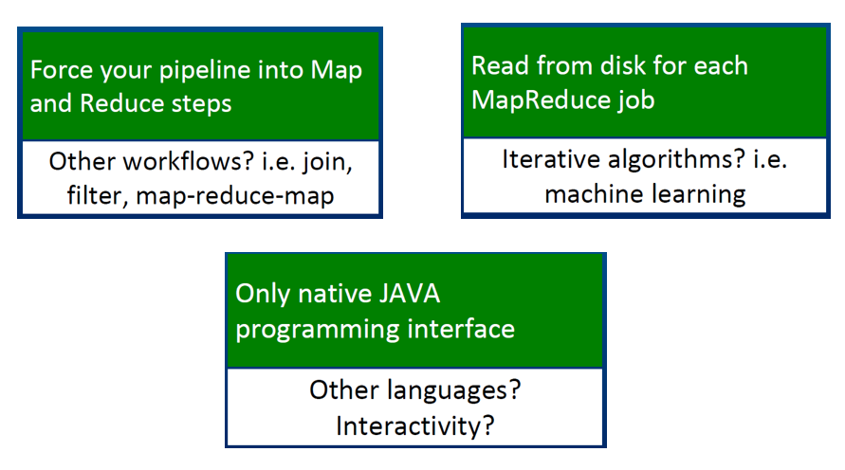
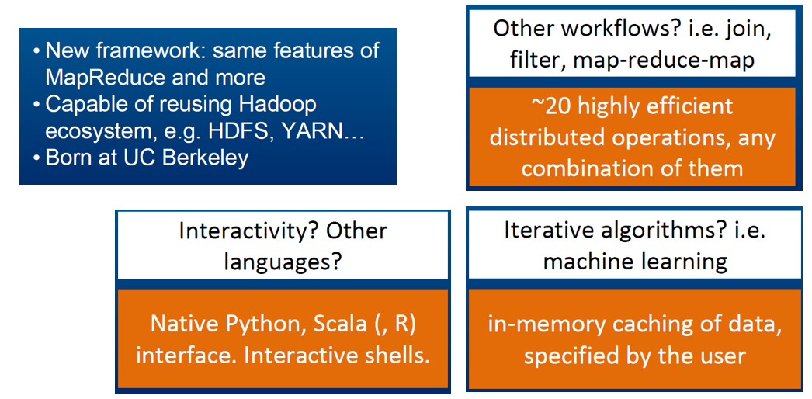
Hadoop vs. Spark

Slide 9
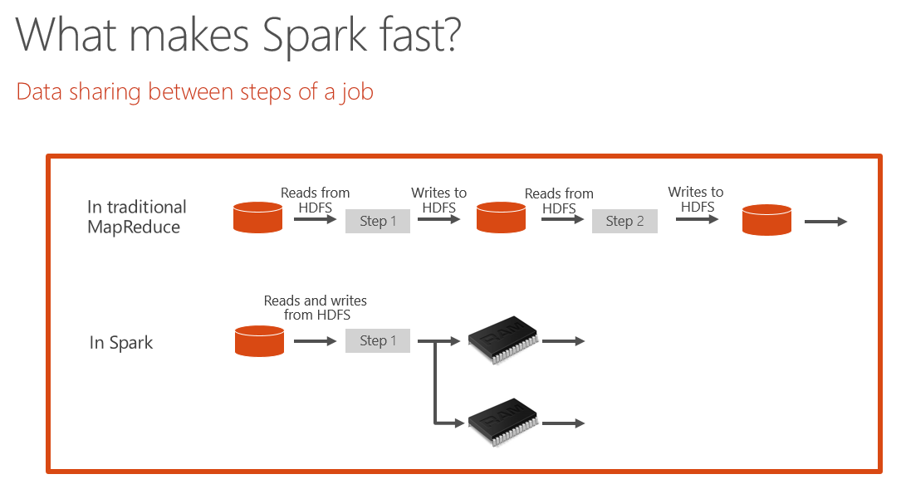
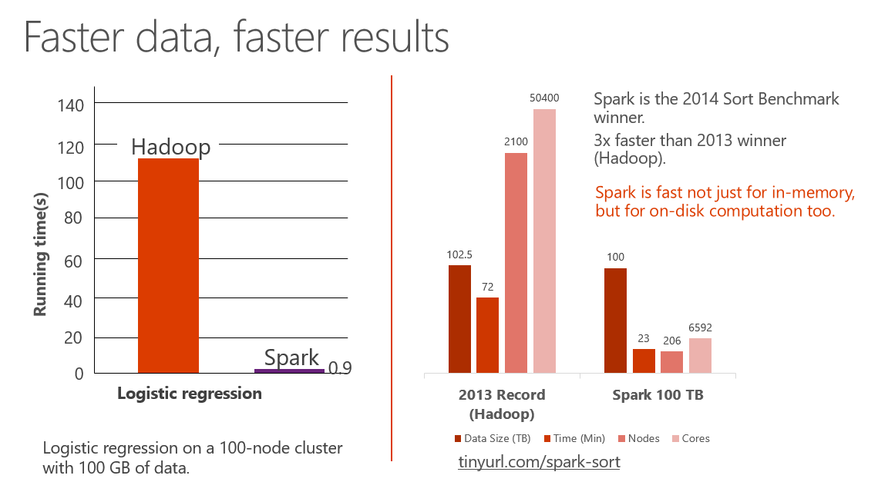
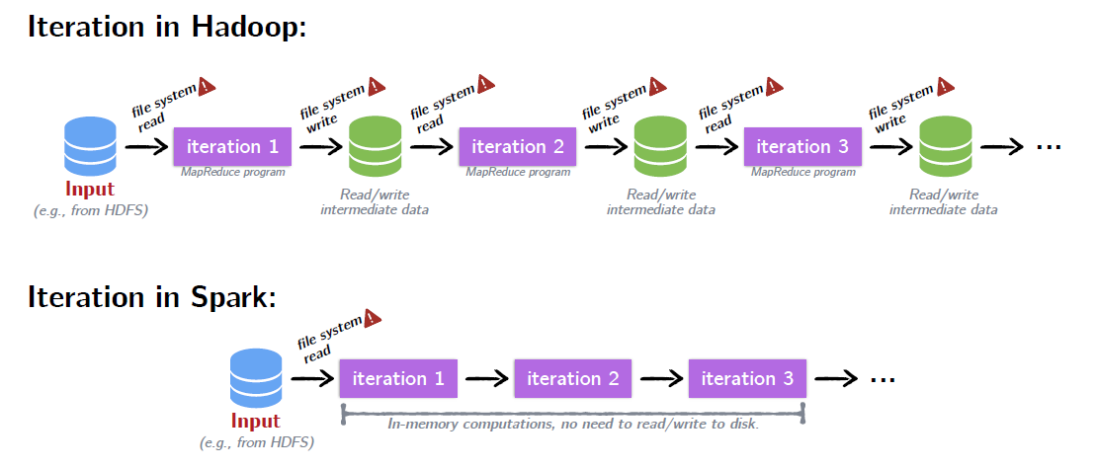
Why sparks is faster?

Slide 10
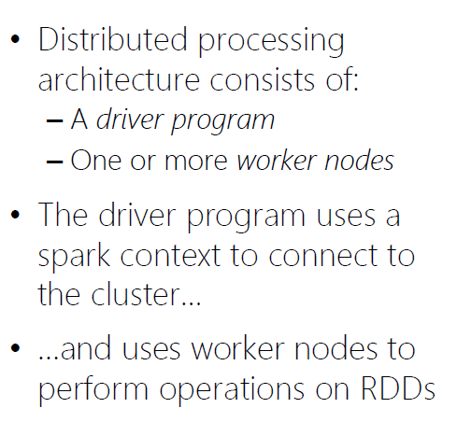
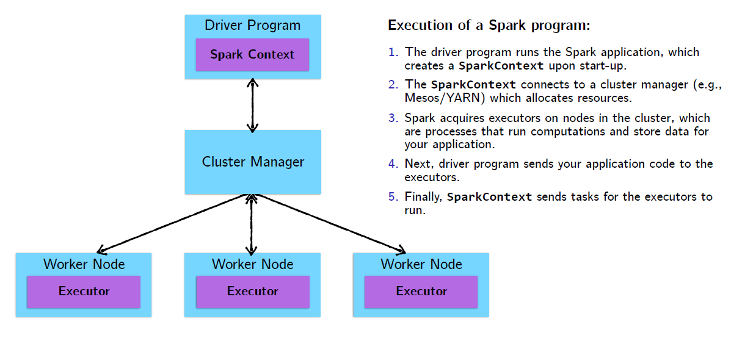
Spark cluster architecture

Slide 11
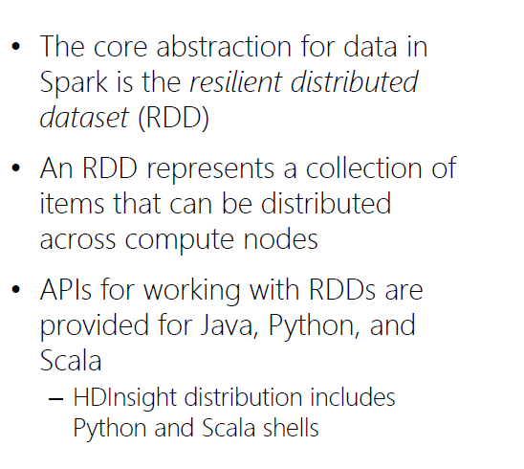
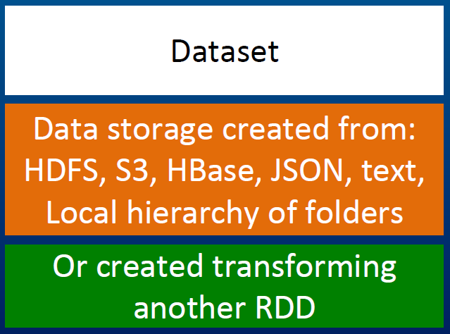
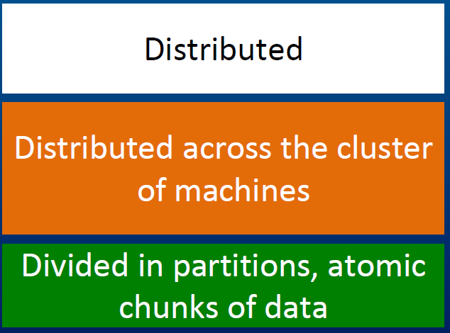
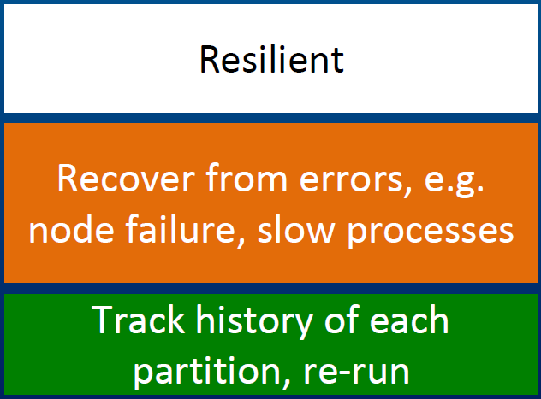
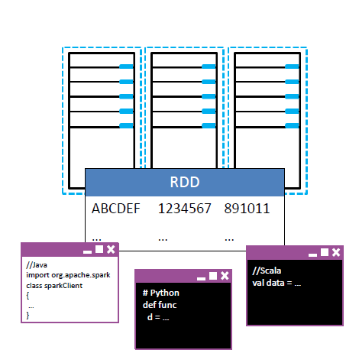
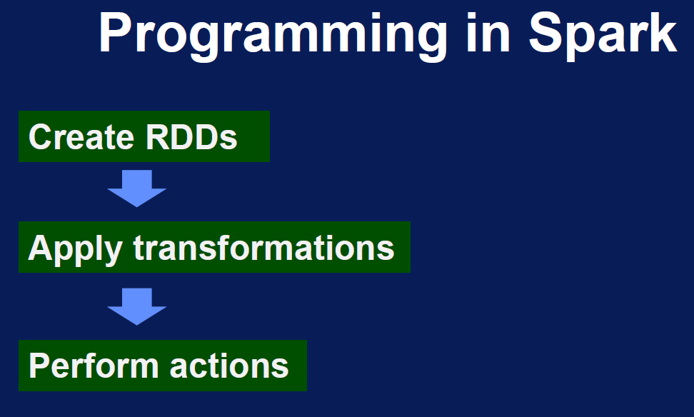
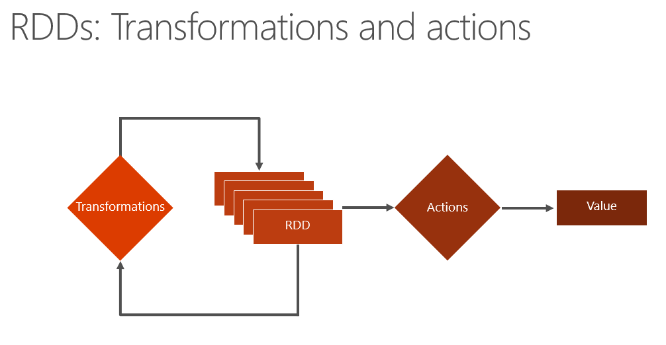
What is RDD?

Slide 12
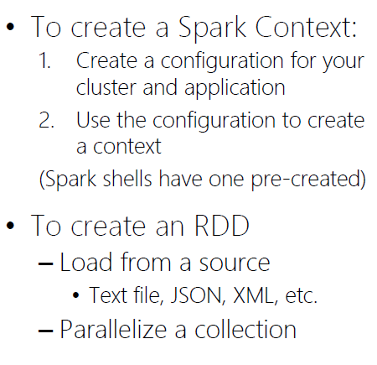
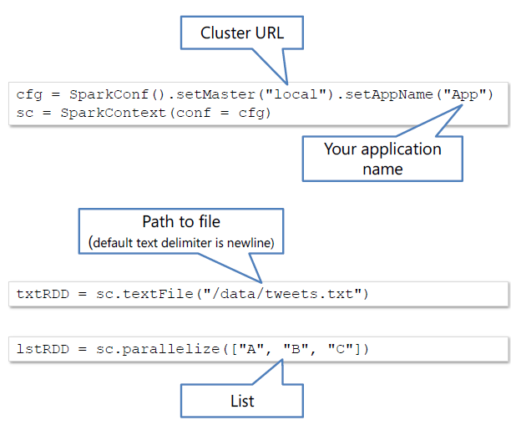
RDD Operations

Slide 13
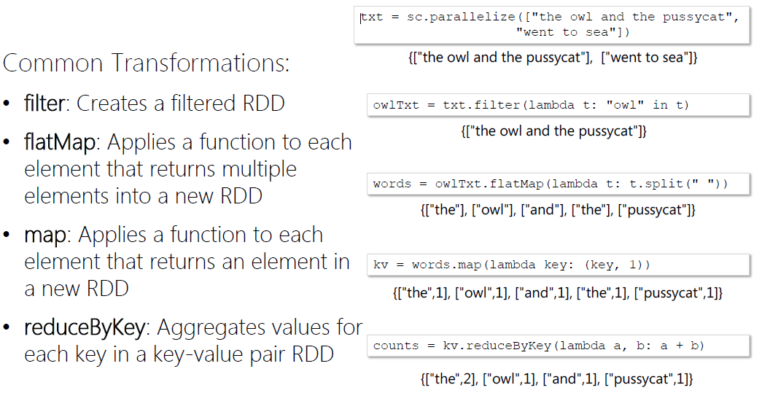
RDD Transformations

Slide 14
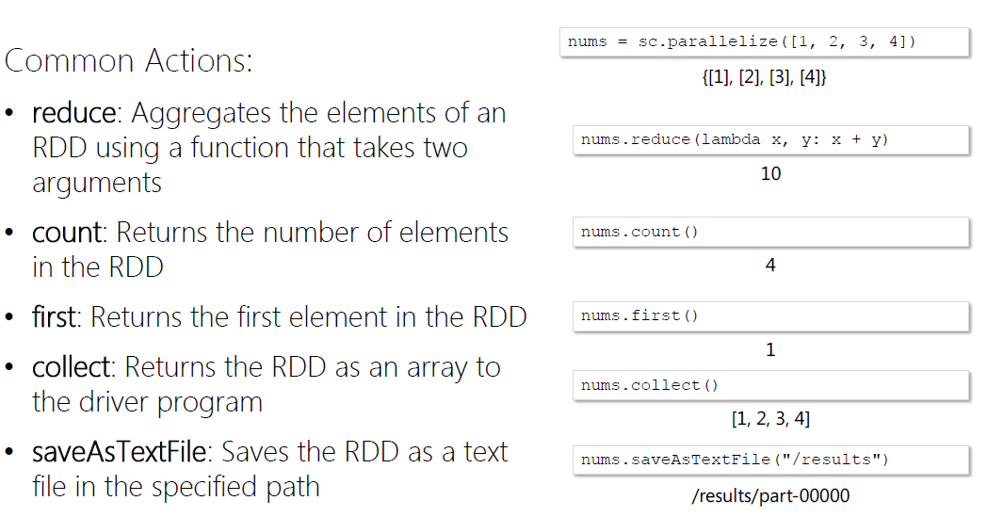
RDD Actions

Slide 15
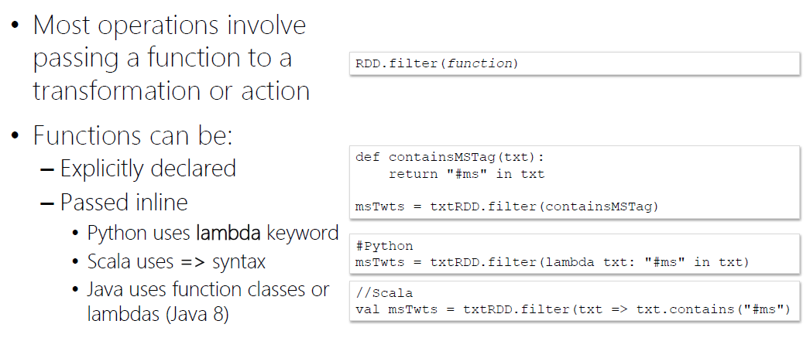
Demo: Working with RDDs in Python

Slide 16
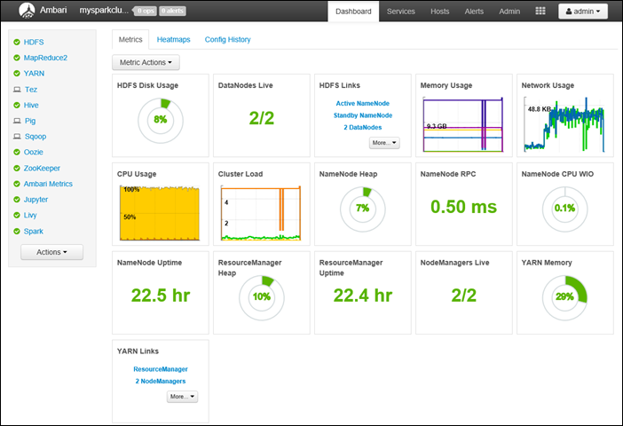
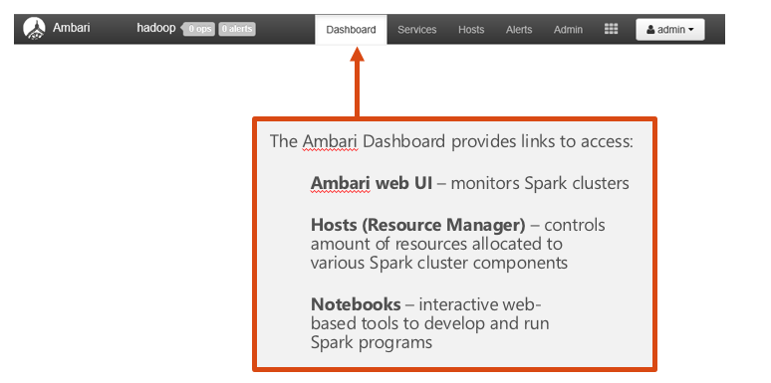
Ambari Dashboard

Slide 17
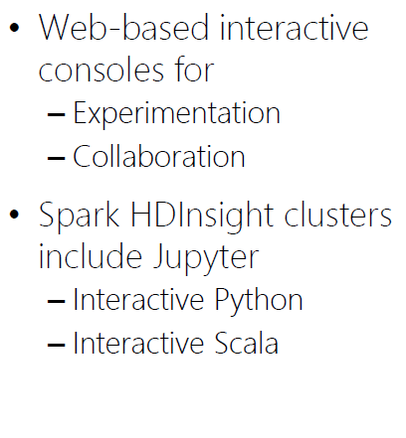
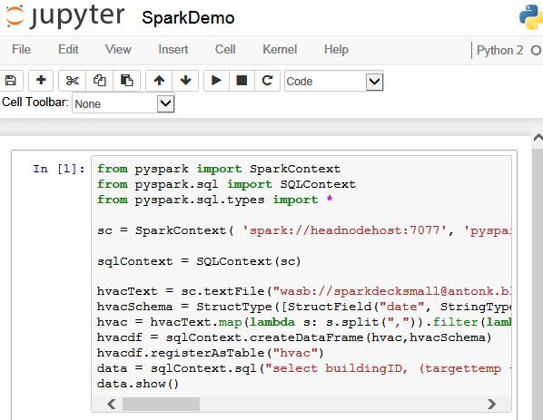
HDInsight Spark: Jupyter notebooks

Slide 18
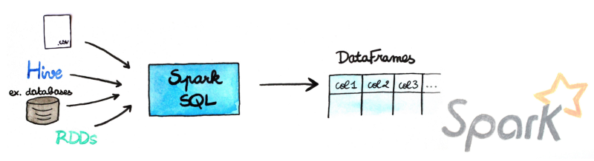
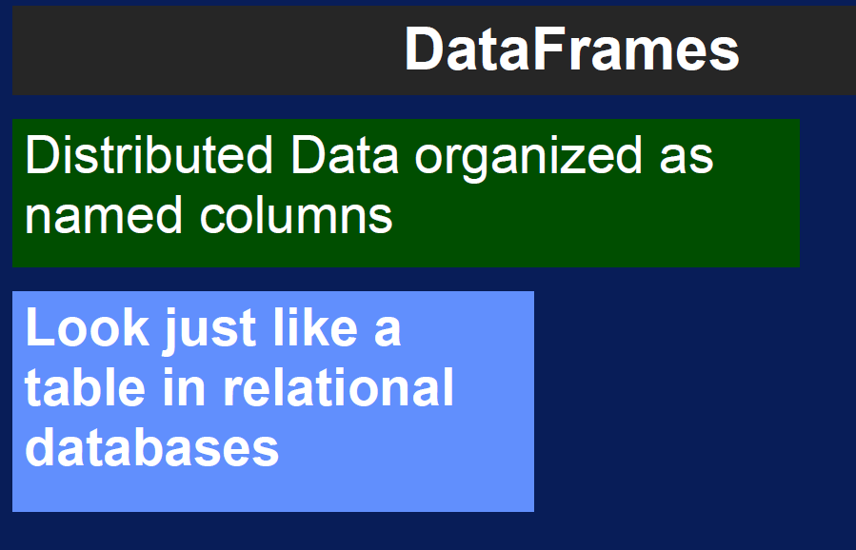
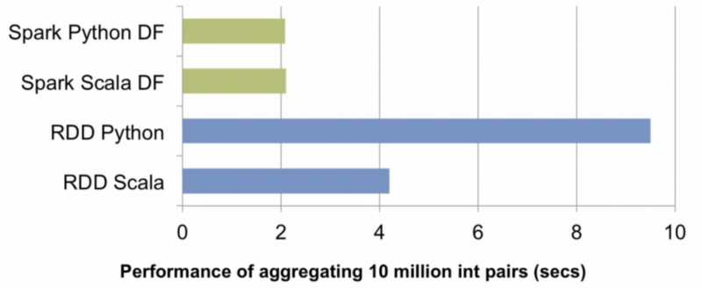
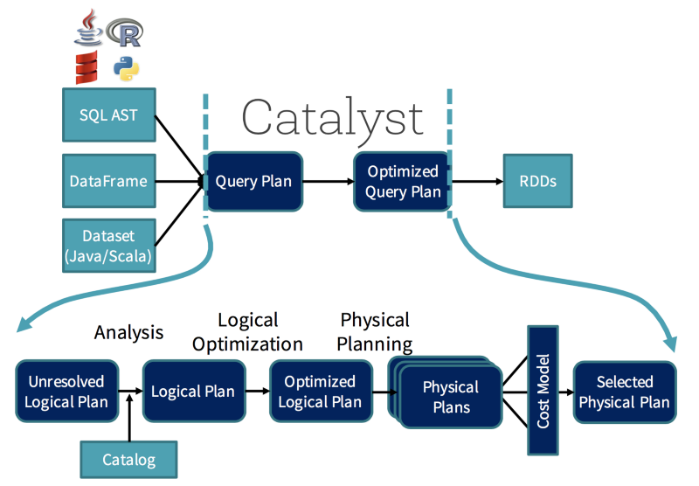
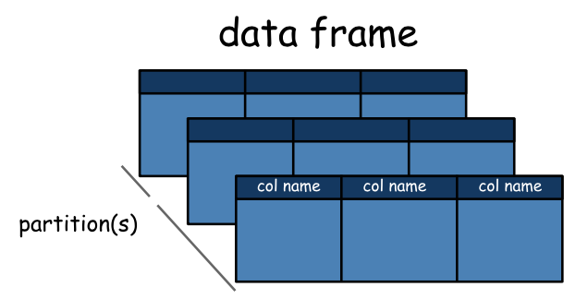
What is DataFrames?

Slide 19
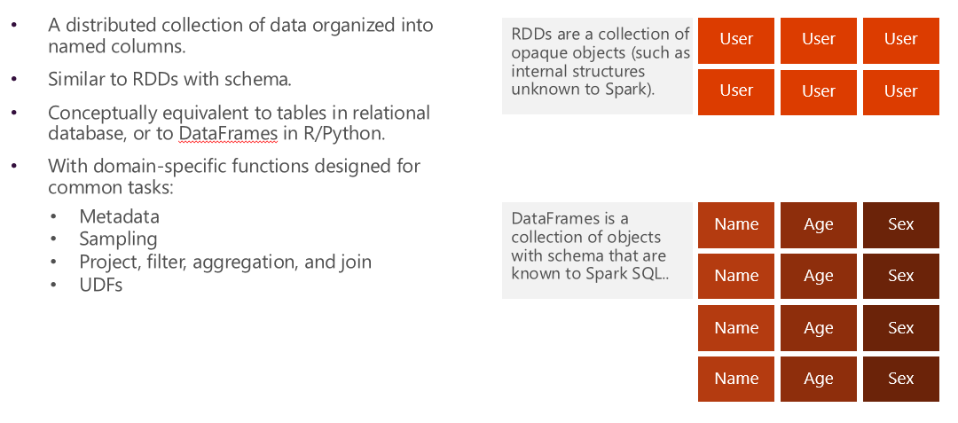
Core abstraction: DataFrames

Slide 20
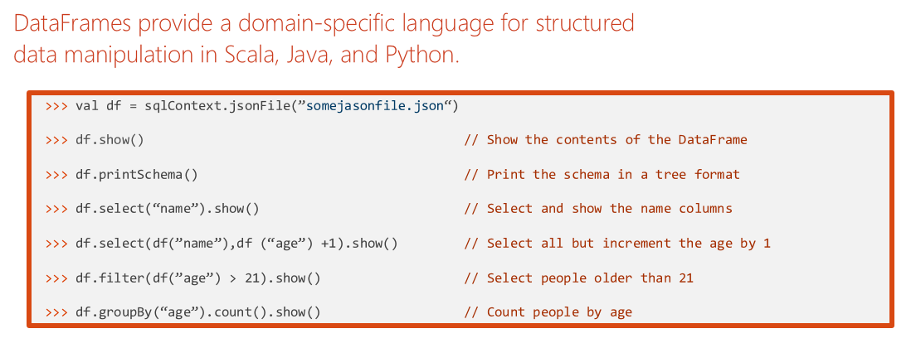
DataFrame Operations

Slide 21
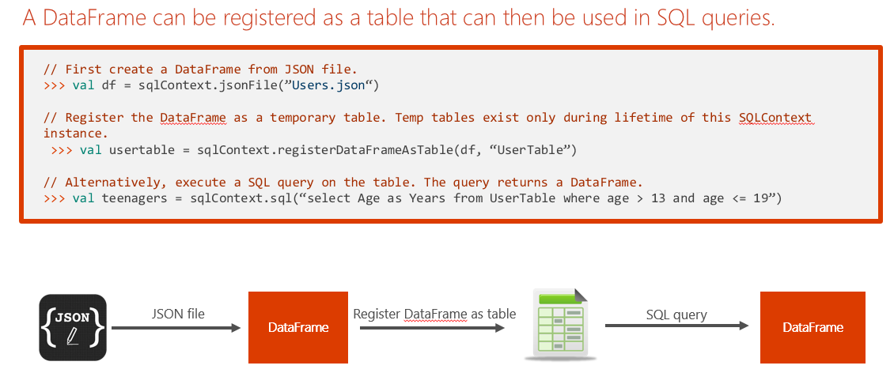
Tables and Queries

Slide 22
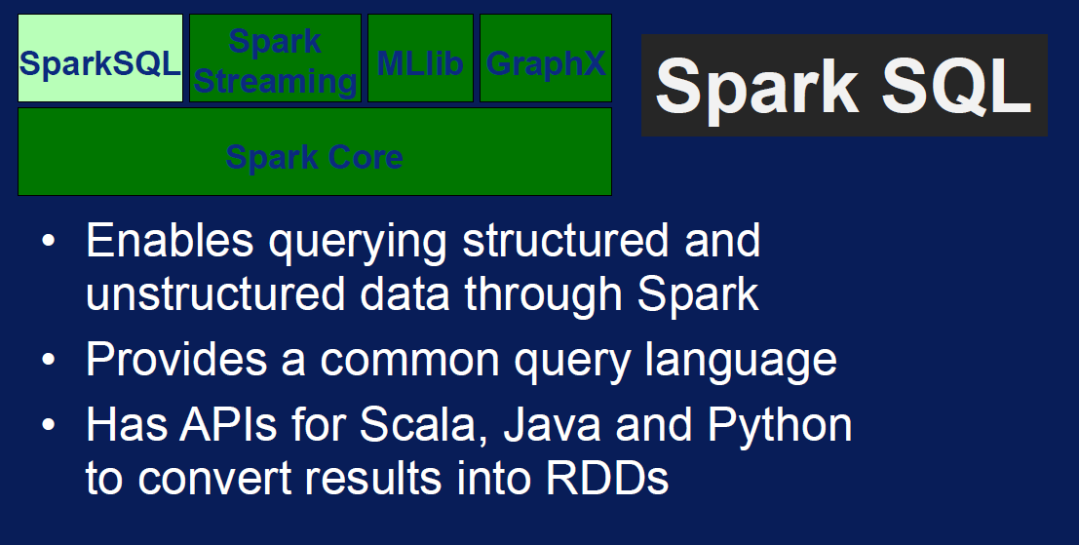
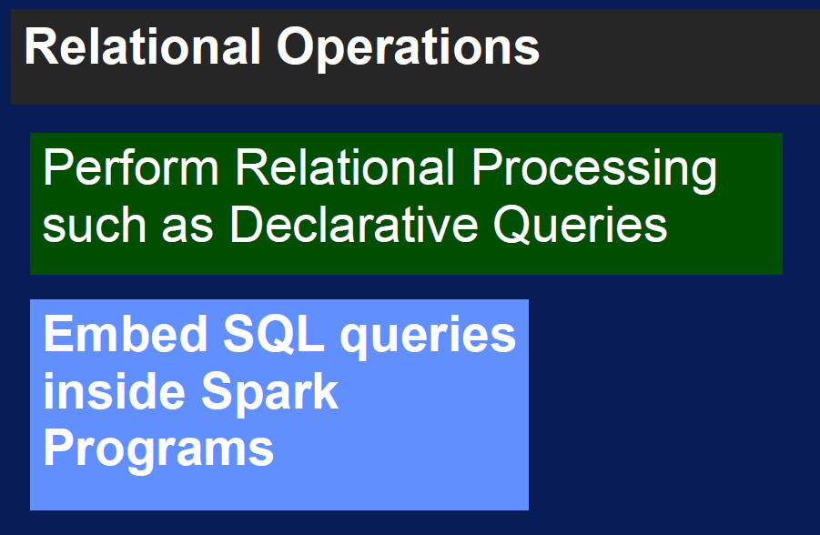
What is Spark SQL?
Install pandas to see the SQL magic on jupyter
sudo -HE /usr/bin/anaconda/bin/conda install pandas

Slide 23
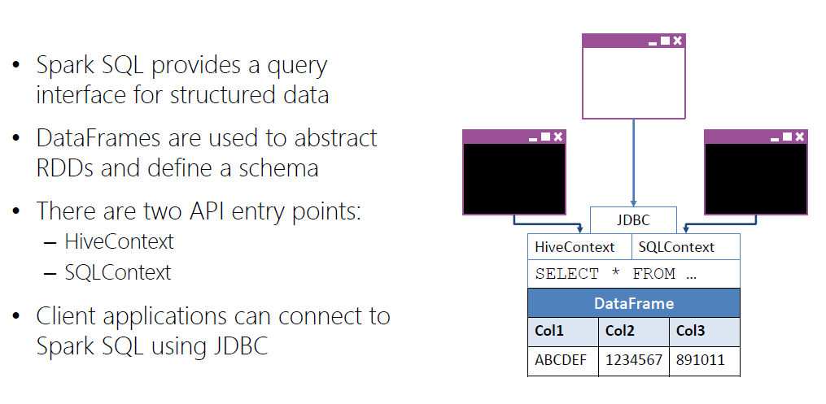
Spark SQL

Slide 24
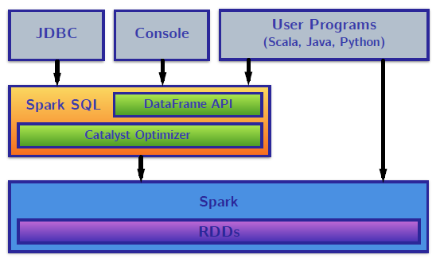
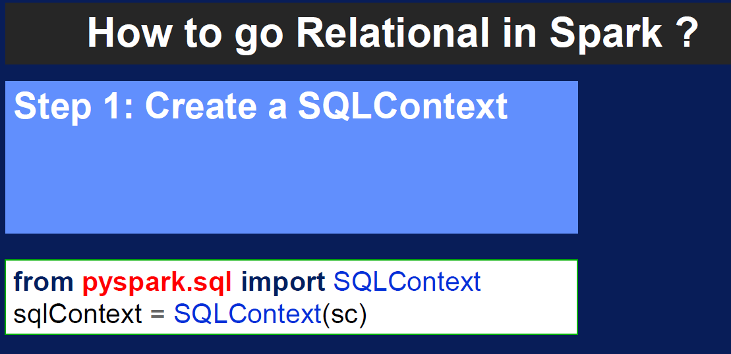
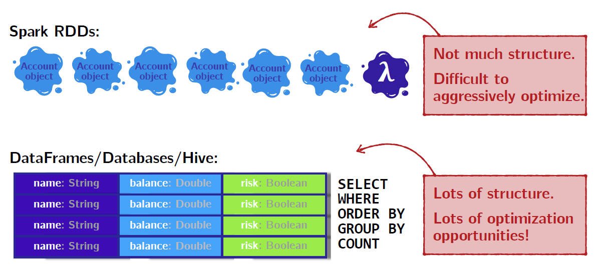
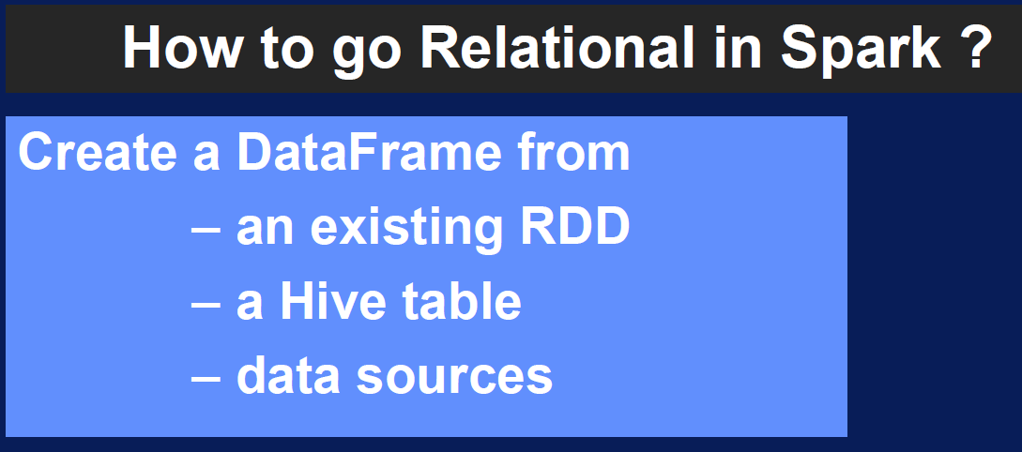
Spark SQL

Slide 25
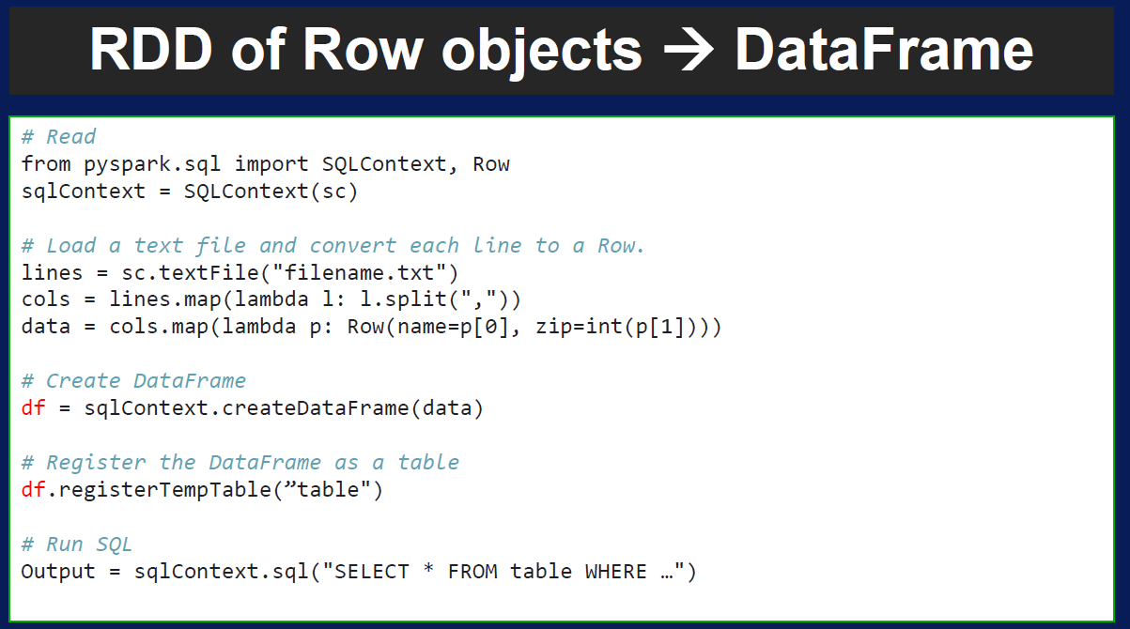
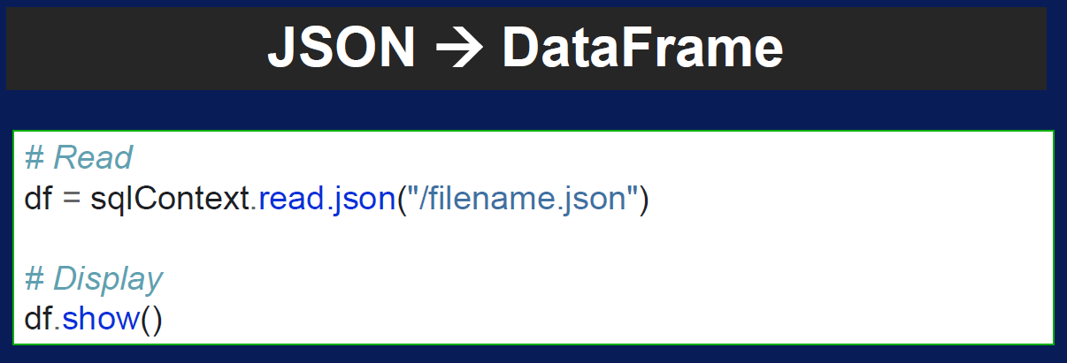
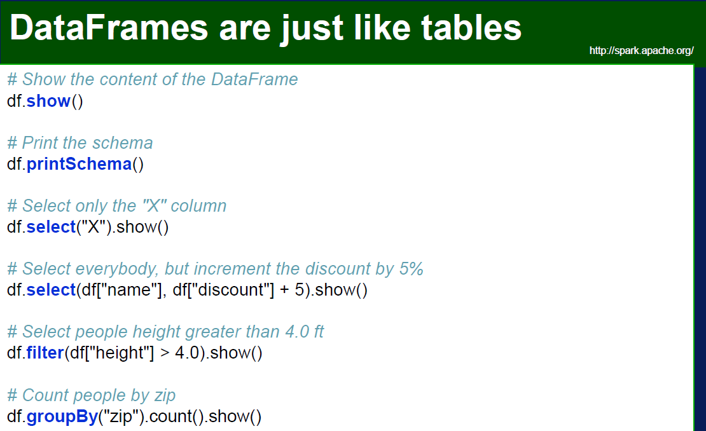

Spark SQL

Slide 26


What is Machine Learning?

Slide 27




How does Machine Learning work?

Slide 28


What is MLlib?

Slide 29

How to.. Machine Learning in Apache Spark?

Slide 30




MLlib Terminology

Slide 31


MLlib Terminology

Slide 32





Examples: Classification
Prepare the Data
Split the Data
Load Source Data
Prepare the Training Data

Slide 33



Examples: Classification
Train a Classification Model
Prepare the Testing Data
Test the Model

Slide 34





Example: Regression
Prepare the Data
Split the Data
Load Source Data
Prepare the Training Data

Slide 35



Example: Regression
Train a Regression Model
Prepare the Testing Data
Test the Model

Slide 36



Example: Pipeline
Define the Pipeline
Run the Pipeline as an Estimator
Test the Pipeline Model

Slide 37



More Example: Text Analysis
Test the Pipeline Model
Run the Pipeline as an Estimator

Slide 38



More Example: Clustering
Create the K-Means Model
Get the Cluster Centers
Predict Clusters

Slide 39





More Example: Recommendation

Slide 40







Now what?

